Slide 1
Joint Distribution
Lecture 2
C B Gupta

Slide 2
Q 5.1.12
(n-dimensional discrete random variables.) Random variables of dimension n>2 can be defined and studied by extending the definitions presented in the 2-dimensional case in a logical way. For example, an n-tuple (X₁,X₂, X₃,…,X_{n}) in which each random variable X₁,X₂, X₃, …,X_{n} is a discrete random variable. The density for such a random variable is given by:

Slide 3
f(x₁,x₂,x₃,…,x_{n}) = P[X₁=x₁,X₂ = x₂, X₃ = x₃,…,X_{n} = x_{n}]
This problem entails the use of three-dimensional random variable.

Slide 4
Multinomial distribution
Items coming off an assembly line are classified as being either nondefective, defective but salvageable, or defective and nonsalvageable. The probabilities of observing items in each of these categories are .9, .08 and .02 respectively. The probabilities do not

Slide 5
change from trial to trial. 20 items are randomly selected and classified. Let X₁ denote the number of nondefective items obtained, X₂ denote the number of defective but salvageable items obtained and X₃ denote the number of defective and nonsalvageable items obtained .
(a) Find P[X₁=15,X₂ =3,X₃=2]
(b) Find the general formula for the density for (X₁,X₂, X₃).

Slide 6
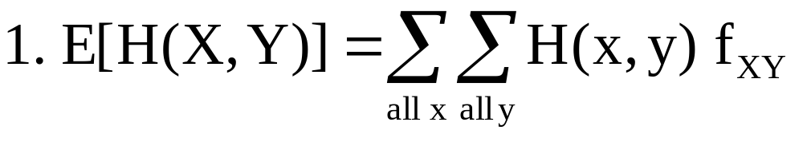
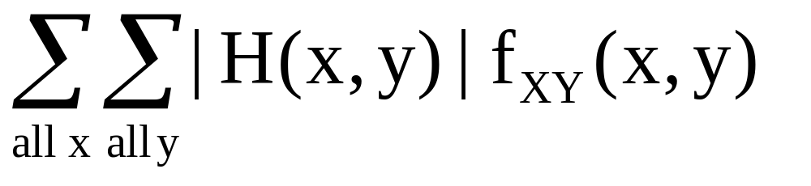
Expectation and Covariance
Def: Let (X,Y) be a 2-dimensional r.v
with joint density f_{XY}. Let H(X,Y) be a
r.v. The expected value of H(X,Y),
denoted byE[H(X,Y)] is given by:
provided
Exists.

Slide 7
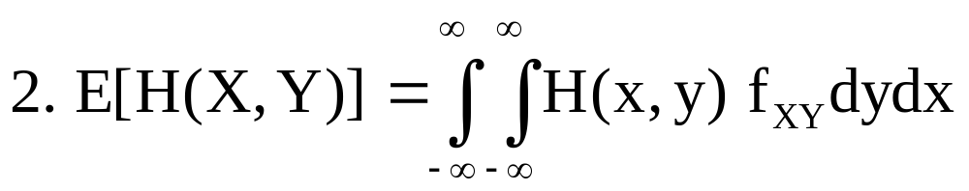
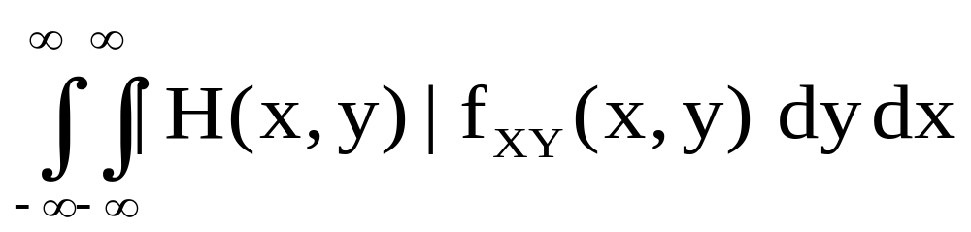
provided
exists for (X,Y) continuous

Slide 8
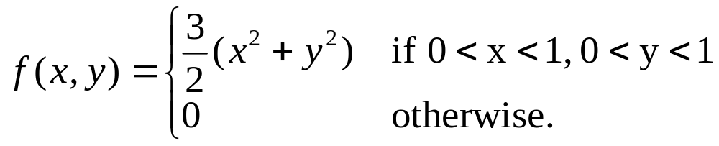
Ex. Let X and Y have joint density function
Find E(X²+Y²)

Slide 9
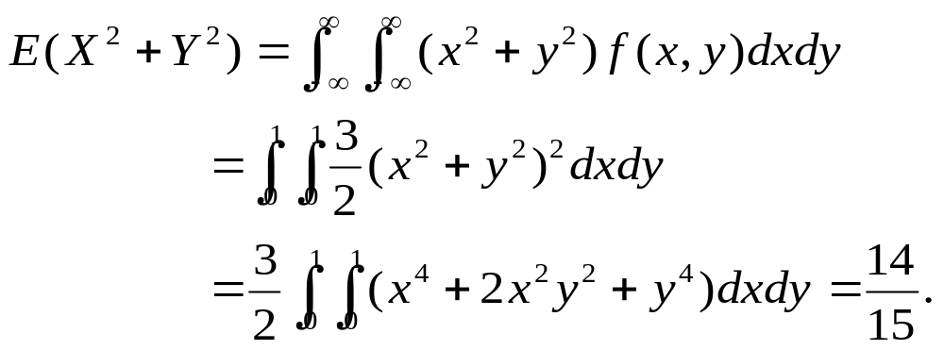
Sol:

Slide 10
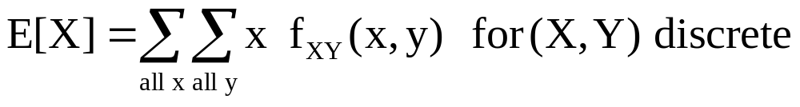
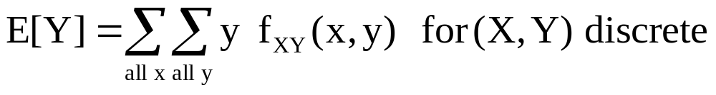
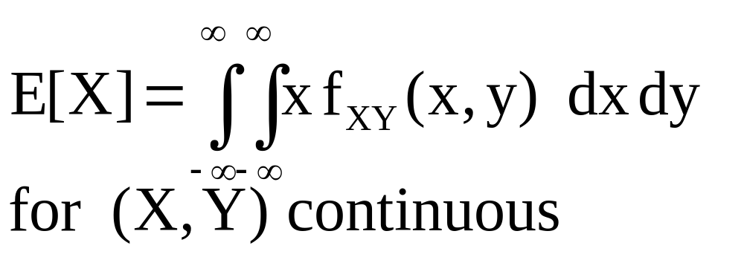
Univariate Average

Slide 11


Slide 12
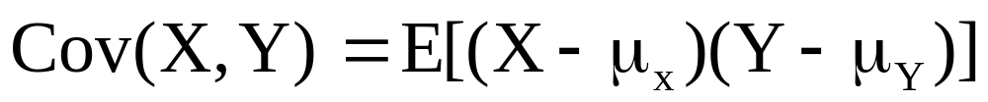
Covariance
Def: Let X and Y be random variables
with means μ_{X} and μ_{Y} respectively. The
Covariance between X and Y, denoted by
Cov(X,Y) is given by:

Slide 13
Remark: If small values of X tend to be
associated with small values of Y and
large values of X with large values of Y,
Then (X-μ_{X})(Y-μ_{Y}) will be positive, yields
a positive covariance and the reverse is
true, that is small values of X tend to associated with large values of Y and vice versa, then (X-μ_{X})(Y-μ_{Y}) yields a negative
covariance. In essence, covariance is an
indication of how X and Y are related.

Slide 14
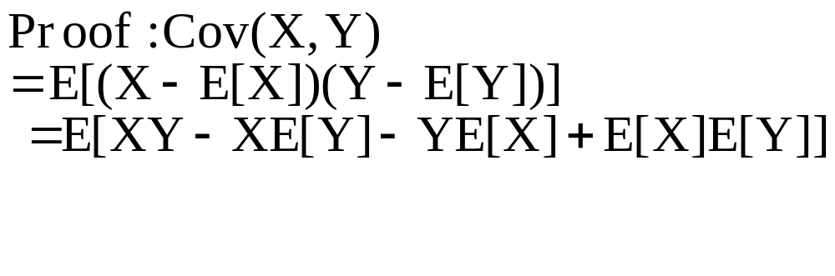
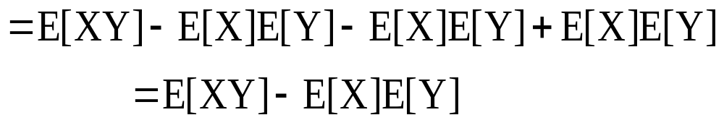
Theorem: Cov (X,Y) = E[XY] – E[X] E[Y]

Slide 15
Theorem: Let (X,Y) be a two dimensional
random variable with joint density f_{XY}. If
X and Y are independent then
E[XY] = E[X] E[Y]
Proof: We shall prove for a continuous
case (Of course, discrete case is similar)

Slide 16
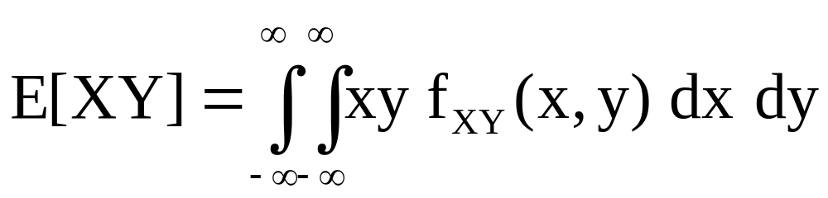
Assume, X and Y has joint density f_{XY} and X and Y are independent. Let f_{X} and f_{Y} denote the marginal densities for X and Y, respectively. Then, we have

Slide 17
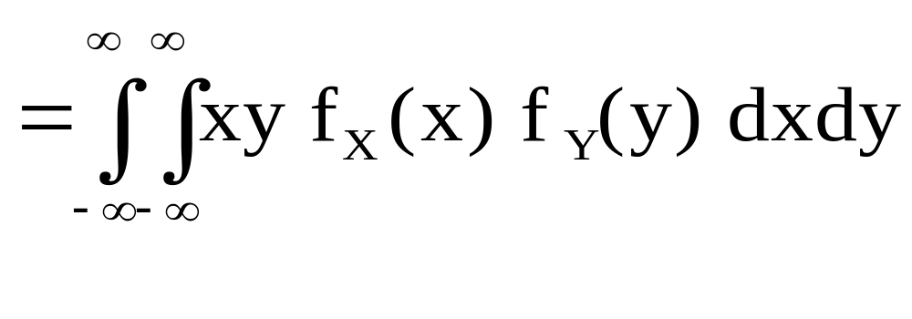
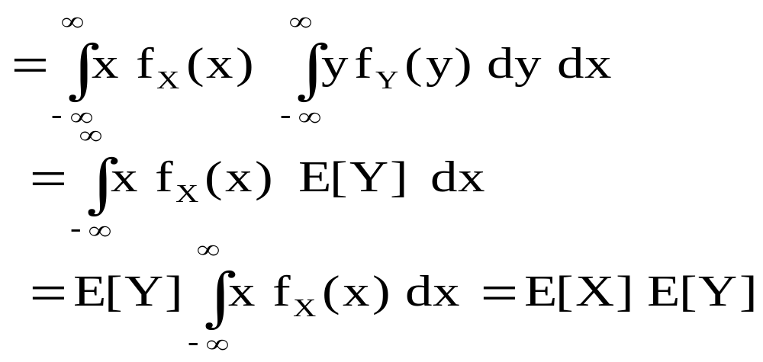
X and Y are independent

Slide 18
Remark:An immediate consequence of
this theorem is that, if X and Y are
independent,then Cov(X,Y) =0. But the
Converse is not true that a zero covariance
implies independence.

Slide 19
Ex. Let X be a r. v. with
p(-1) = p(0) = p(1) = 1/3.
Letting Y=X², we have
E[X]=(-1+0+1)/3=0,
E[Y]=E(X²)=((-1)²+0²+(1)²)/3=2/3,
E[XY]=E(X³)=((-1)³+0³+(1)³)/3=0.
Thus E[XY]=E[X]E[Y] while, clearly, X and Y are dependent.

Slide 20
Exercise
19. The joint density for (X,Y) , where X
is the inside and Y is the outside
Barometric pressure on an air support roof

Slide 21
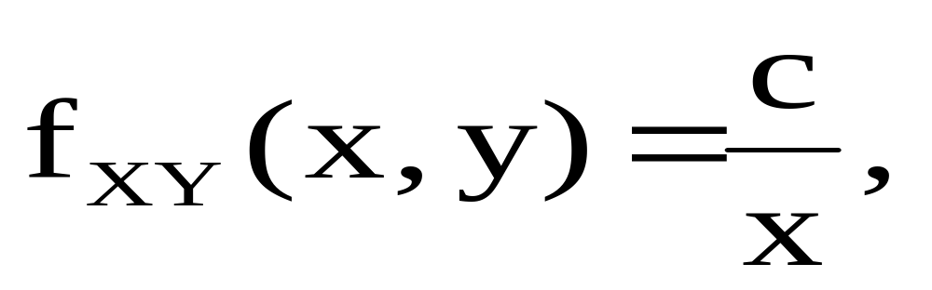
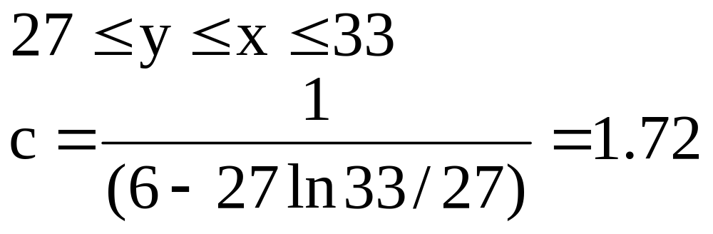
is given by:
(a) Find E[X],E[Y[,E[XY], and Cov(X,Y)
(b) Find E[X-Y].

Slide 22
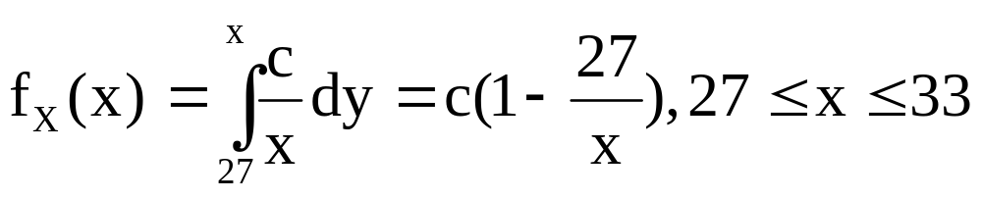
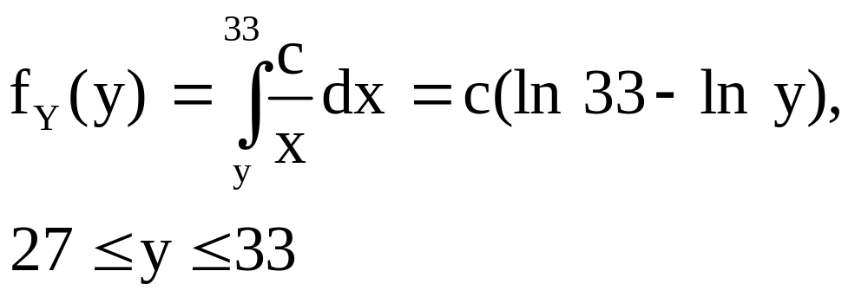
Sol: The marginal densities for X and Y are: (a)

Slide 23
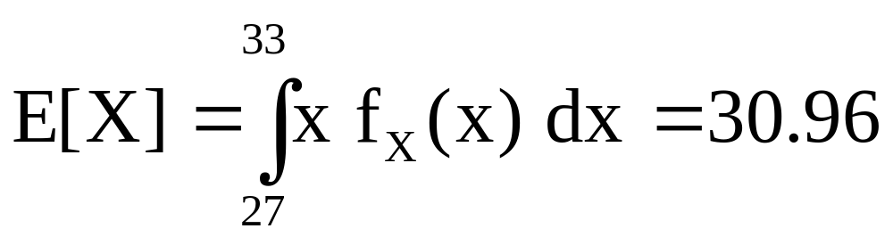
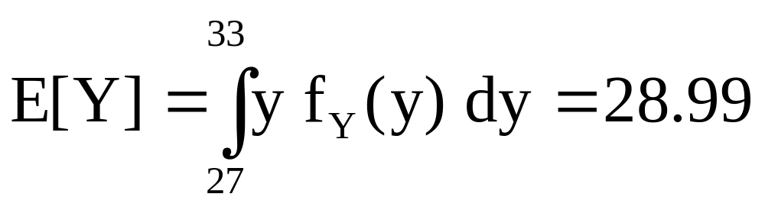
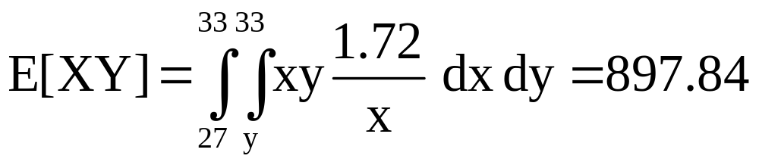
(a)

Slide 24
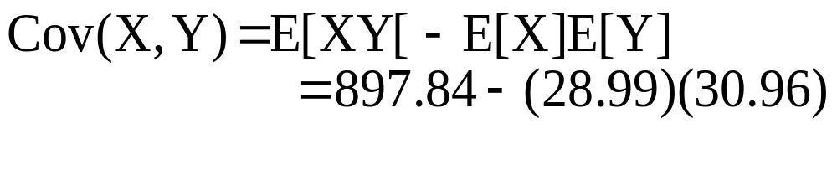
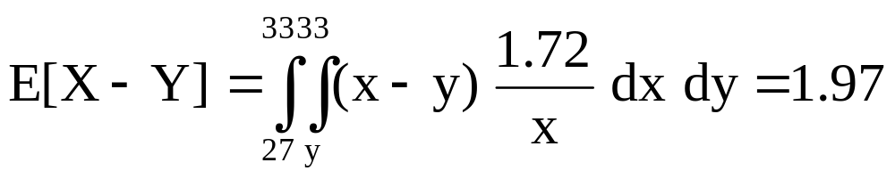
(b)

Slide 25
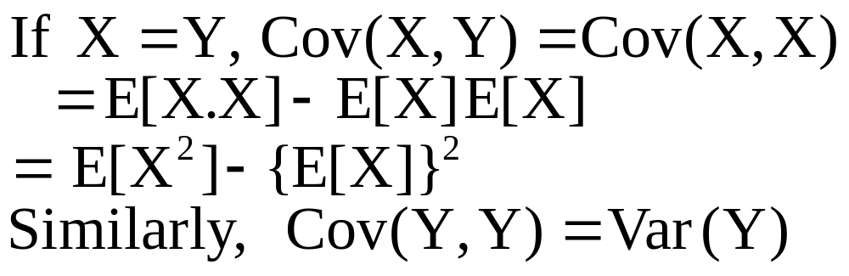
(27) Show that if X=Y, then
Cov(X,Y) =Var(X) = Var(Y)
Proof:

Slide 26
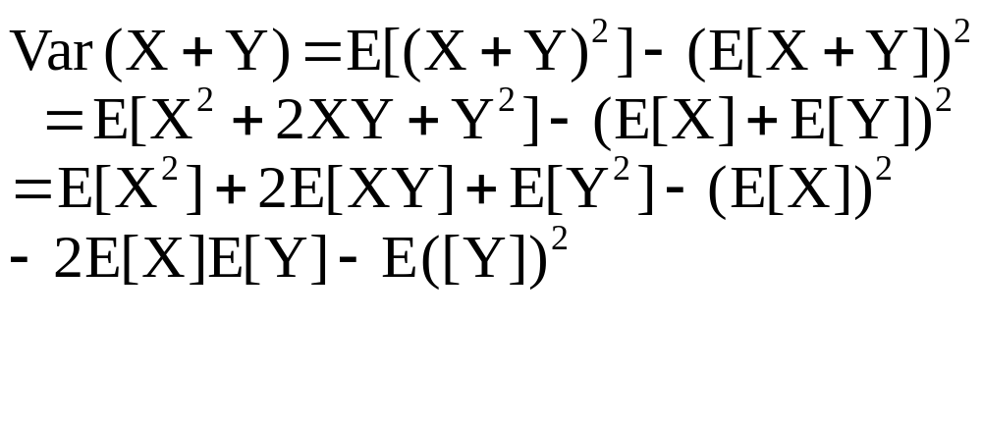
Prove that Var(X+Y) = Var(X) +
Var(Y) +2 Cov(X,Y)
Proof:

Slide 27
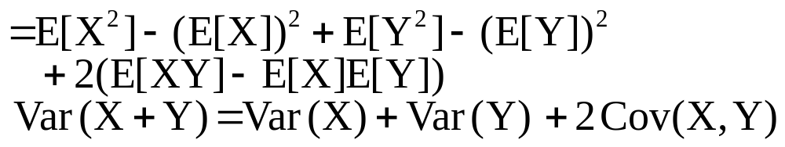

Slide 28
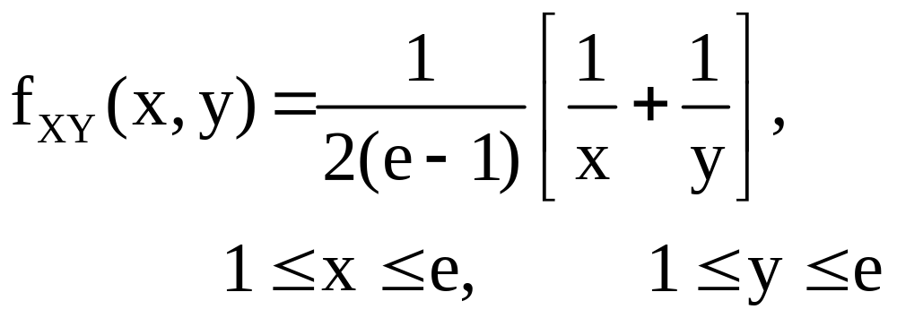
28. Let the joint density for (X,Y) be given by
(a). Show that it’s a valid joint density.
(b). Find E[X] and E[Y]
(c). Find E[XY]
(d). Are X and Y independent?

Slide 29
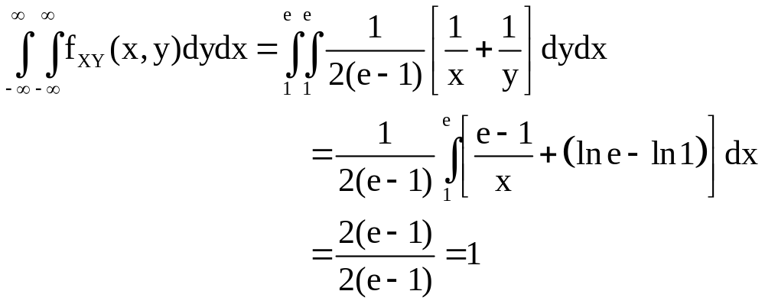
Sol (a).

Slide 30
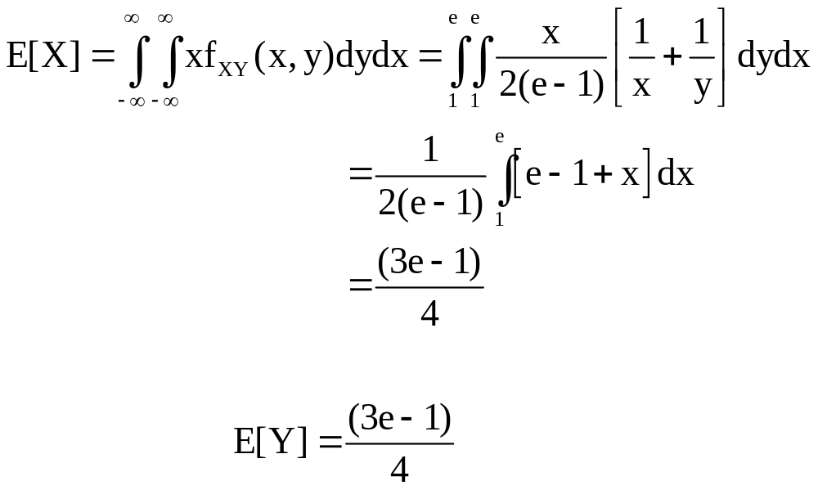
Sol (b).
Similarly

Slide 31
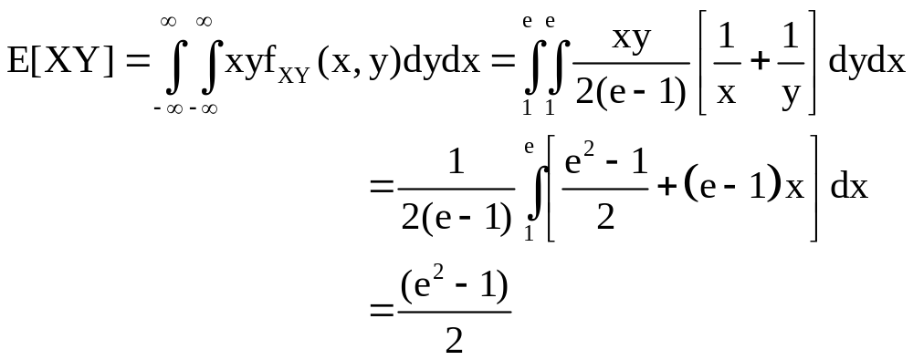
Sol (c).

Slide 32
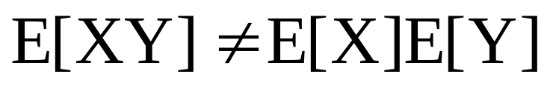
Sol (d). No
Since

